Slide 1

Note: The data and information in this document is reflective of a hypothetical situation and client. This document is to be used for KPMG Virtual Internship purposes only.
Sprocket Central Pty Ltd
Data analytics
Created by Tram Nguyen

Slide 2
Note: The data and information in this document is reflective of a hypothetical situation and client. This document is to be used for KPMG Virtual Internship purposes only.
Customer concern
1. What are the trends in the underlying data?
2. Which customer segment has the highest customer value?
3. What do you propose should be Sprocket Central Pty Ltd ’s marketing and growth strategy?
4. What additional external datasets may be useful to obtain greater insights into customer preferences and propensity to purchase the products?
Specifically, it is important to specify who Sprocket Central Pty Ltd’s marketing team should be targeting out of the new 1000 customer list as well as the broader market segment to reach out to.

Slide 3
Note: The data and information in this document is reflective of a hypothetical situation and client. This document is to be used for KPMG Virtual Internship purposes only.
What is RFM model?
The RFM model is a crucial transaction data analysis tool within the Customer360 analytics platform—a customer-centric platform that contains all customer data and analyzes various aspects of each customer.
The RFM model provides a comprehensive view of customer behavior, helping companies gain deeper insights into their customers.
RFM stands for three key factors:
Recency (R): This measures how recently a customer has interacted with or made a purchase from you. It helps assess the "freshness" of the relationship between the company and the customer.
Frequency (F): This measures how often a customer has purchased or interacted with you over a specific time period. It indicates whether the customer tends to engage or shop regularly.
Monetary (M): This is the total value a customer has spent on your products or services over a specific period. It shows the actual worth of each customer's transactions.
The RFM model provides a consolidated view of customer behavior, helping you better understand and segment your customers accordingly.

Slide 4
Note: The data and information in this document is reflective of a hypothetical situation and client. This document is to be used for KPMG Virtual Internship purposes only.
Benefits of the RFM Model for Year-End Sales Growth Goals
Gain deeper customer insights: The RFM model allows you to categorize customers into groups based on their behavior. This helps you better understand the needs, preferences, and purchasing habits of each customer segment.
Enable personalized customer care: By analyzing RFM data, you can create personalized care plans for each customer group, offering content, promotions, and interactions that align with their current relationship with your brand.
Optimize marketing campaigns: The RFM model helps you design highly targeted marketing campaigns while optimizing resources based on the priority and value of each customer group.
Increase conversion rates: Personalized care and engagement driven by the RFM model can significantly increase customer conversion rates, leading to higher sales and profits.
Reduce churn rates: By engaging and delivering value based on customer needs, the RFM model helps reduce customer attrition and fosters long-term loyalty.
Optimize resource allocation: RFM analysis allows you to focus resources on high-potential customer segments, thereby optimizing spending and reducing unnecessary costs.

Slide 5
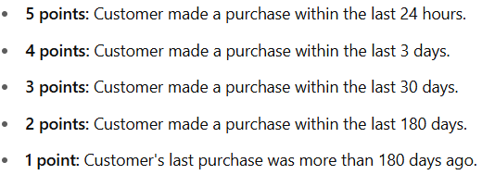
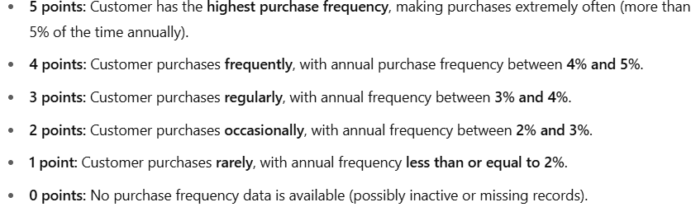
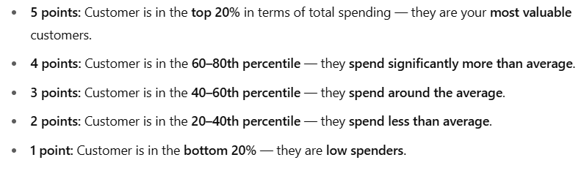
Note: The data and information in this document is reflective of a hypothetical situation and client. This document is to be used for KPMG Virtual Internship purposes only.
Explanation of the R, F, M Score Scale
In this analysis, each of the R, F, and M indicators is divided into 4 levels (1–2–3–4), corresponding to increasing or decreasing levels of positive customer behavior.
R – Recency (Time since last purchase):
Measured by the number of days between the customer’s last purchase and December 31, 2017.
A customer with R = 1 made a recent purchase (fewer days since last purchase), which is more positive.
A customer with R = 4 has not made a purchase in a long time (many days have passed).
The lower the R score, the more recent the purchase and the stronger the customer engagement.
F – Frequency (Purchase frequency):
Calculated as the average number of purchases per year (total number of purchases ÷ customer lifetime in years).
A customer with F = 1 belongs to the group with the fewest purchases.
A customer with F = 4 is in the group with the most frequent purchases.
The higher the F score, the more frequently the customer buys.
M – Monetary (Amount spent):
Measured as the average amount spent per year (total spending ÷ customer lifetime in years).
A customer with M = 1 belongs to the lowest spending group.
A customer with M = 4 belongs to the highest spending group.
The higher the M score, the more valuable the customer is in terms of spending.

Slide 6
Note: The data and information in this document is reflective of a hypothetical situation and client. This document is to be used for KPMG Virtual Internship purposes only.
Customer Segmentation
Segment | RFM code | Description
Champions | 555, 554, 544, 545, 454, 455, 445 | These are customers who make frequent and high-value purchases. They are very loyal, willing to spend, and likely to quickly complete another purchase.
Loyal Customers | 543, 444, 435, 355, 354, 345, 344, 335 | These customers have medium to high spending and shop frequently.
Potential Loyalists | 553, 551, 552, 541, 542, 533, 532, 531, 452, 451, 442, 441, 431, 453, 433, 432, 423, 353, 352, 351, 342, 341, 333, 323 | Customers who have made recent purchases, spend moderately, and have bought several times.
Recent Customers | 512, 511, 422, 421, 412, 411, 311 | Customers who recently made their first purchase, have low purchase value, and do not shop regularly.
Promising | 525, 524, 523, 522, 521, 515, 514, 513, 425, 424, 413, 414, 415, 315, 314, 313 | Customers who have made recent purchases with significant potential but have not yet become frequent buyers.
Customers Needing Attention | 535, 534, 443, 434, 343, 334, 325, 324 | Customers with average purchase frequency and value who have not bought recently.
About to Sleep | 331, 321, 312, 221, 213 | Customers who haven’t bought in a while, and when they did, they purchased infrequently and spent little.
At Risk | 55, 254, 245, 244, 253, 252, 243, 242, 235, 234, 225, 224, 153, 152, 145, 143, 142, 135, 134, 133, 125, 124 | Customers who haven’t returned for a long time but used to shop fairly often and spend a moderate amount.
Can’t Lose Them | 155, 154, 144, 214, 215, 115, 114, 113 | Customers who haven’t returned for a long time but used to be frequent and high-value buyers. Businesses should take action to reactivate them.
Hibernating | 332, 322, 231, 241, 251, 231, 235, 222, 223, 222, 132, 123, 122, 212, 211 | Customers who haven't returned for a long time, used to buy infrequently, and spent little.
Lost | 111, 112, 121, 131, 141, 151 | Customers who haven’t returned for a very long time. Their buying frequency and value are very low. These are customers who are likely exploring or have moved on to other products/services.

Slide 7
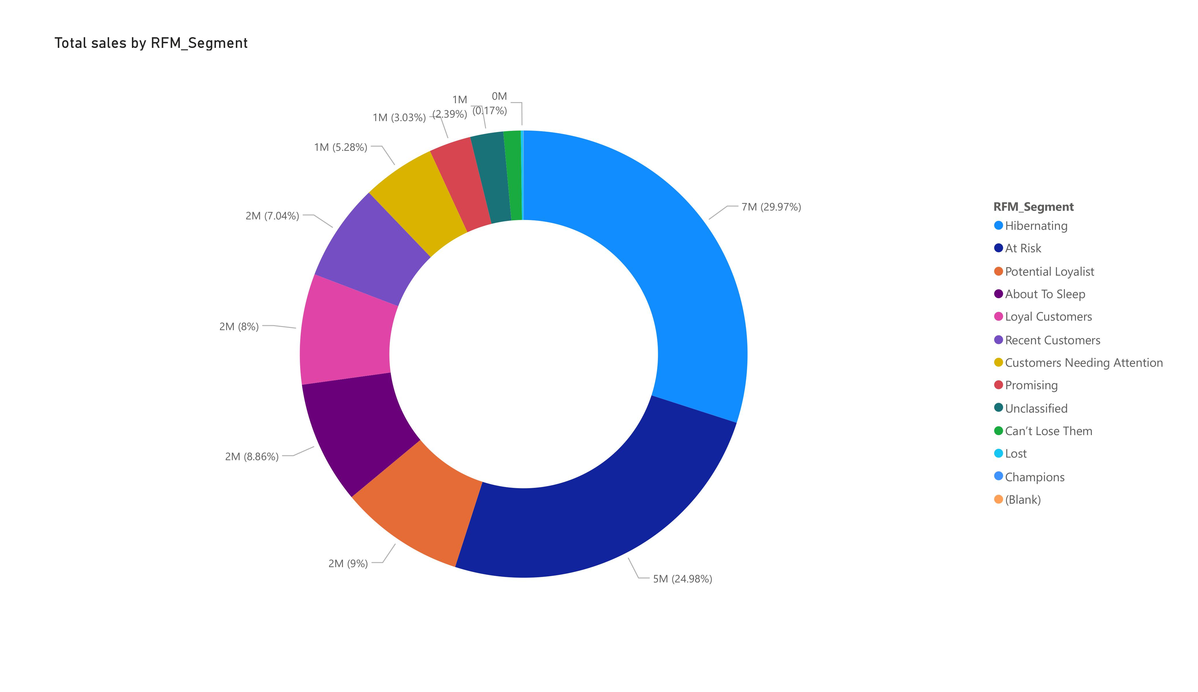
Which customer segment has the highest customer value?
Note: The data and information in this document is reflective of a hypothetical situation and client. This document is to be used for KPMG Virtual Internship purposes only.
1.Champions contribute the most to sales (29.97%)
Interpretation: These are your best customers — recent, frequent buyers with high spend.
Action: Keep them engaged through loyalty rewards, exclusive deals, or early access.
2. At Risk segment also contributes significantly (24.98%)
Interpretation: These customers used to be valuable but haven’t interacted in a while.
Action: Urgently target them with re-engagement campaigns (e.g., limited-time offers or surveys).
3. Loyal Customers (9%) and Potential Loyalists (8.86%) are strong performers
Interpretation: They're regularly purchasing and could become champions.
Action: Nurture them with personalized communications or loyalty programs to elevate them.
4. Hibernating customers account for a large chunk (7M = 29.97%)
Interpretation: These customers haven’t purchased in a long time and don’t spend much.
Action: Consider win-back strategies or segment them out of high-cost marketing to save resources.
5. Low engagement groups (e.g., Lost, Unclassified, Promising) are minimal contributors
Interpretation: Small slices like “Lost” (0.17%) and “Unclassified” suggest limited immediate value.
Action: Focus less on them unless they show signs of revival.

Slide 8
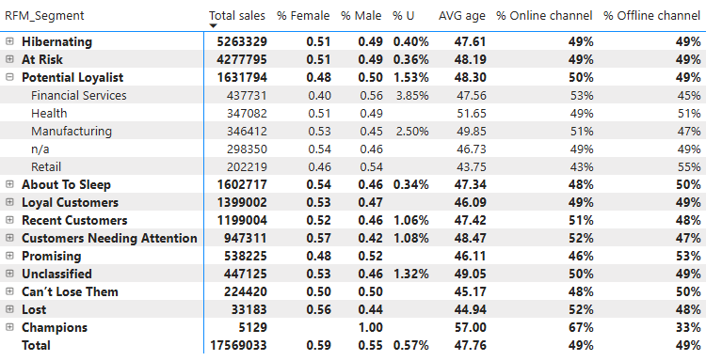
Customer segments by demography
Note: The data and information in this document is reflective of a hypothetical situation and client. This document is to be used for KPMG Virtual Internship purposes only.
Hibernating (30% of sales)
AVG age: 47.6 | Balanced gender | Low % unknown (U): 0.40%
Channel Use: 49% online, 49% offline
Insight: This large group is equally split across channels and genders. A general reactivation campaign with broad targeting could be effective.
At Risk (25%)
AVG age: 48.2 | Low engagement from unknown users (0.36%)
Channels: Also 49% online/offline
Insight: Similar to Hibernating but slightly younger. Consider segmented re-engagement messaging based on past products purchased.
Potential Loyalist (9.3%)
Notable Sub-Segment:
Health and Financial Services skew older (AVG ~51.6 & 47.6), with a higher % unknown (e.g. 3.85% for Financial).
Retail users are younger (AVG 46.7), mostly offline.
Insight: Potential for conversion to Loyal or Champions; segment-specific strategies work best (e.g., financial incentives for younger Retail buyers, trust-building for Health).
Loyal Customers (6.8%)
AVG age: 46.1 | Slight male skew | Low %U
Channel: Balanced
Insight: Strong segment. Maintain with loyalty rewards, referral bonuses.
Recent Customers (6.3%)
AVG age: 48.4 | Online preference (51%)
Insight: Keep them engaged quickly post-purchase via email workflows or personalized online deals.
Champions (0.03%)
Small in number but high value (29.97% of sales) | Older (AVG age 57) | Preferred online (67%)
Insight: VIP treatment — early product releases, personalized offers. Leverage their online preference.
Lost / Unclassified / Can't Lose Them
Lost: Tiny impact (0.19%) | Older & offline (52%)
Can't Lose Them: Valuable but disengaging
Unclassified: High % unknown users (1.32%)
Insight: Only worth pursuing with tailored recovery tactics if CAC (customer acquisition cost) is low.

Slide 9
Note: The data and information in this document is reflective of a hypothetical situation and client. This document is to be used for KPMG Virtual Internship purposes only.
Strategic recommendations
1. Financial Services Professionals
Profile: Desk-bound, high-income, time-constrained.
Strategies:
Promote high-end, time-efficient products (e.g. e-bikes, foldables for commuting).
Position biking as a stress-relief or wellness activity.
Offer concierge services: pickup/drop-off for maintenance, or premium service bundles.
Schedule evening or weekend demo/test ride events in urban centers or near business parks.
2. Manufacturing Workers
Profile: Shift-based schedules, more physically demanding jobs.
Strategies:
Highlight durability and comfort in marketing (e.g. rugged bikes, ergonomic seats).
Offer incentives for commuting by bike—partner with factories or unions for group discounts.
Promote maintenance support and rugged gear suited for industrial zones or long distances.
3. Retail Employees
Profile: Often younger or mid-income, flexible but on their feet all day.
Strategies:
Focus on affordability and functionality—bikes that are easy to maintain.
Create buy-now-pay-later plans or employee purchase programs with retail chains.
Use social media and in-store signage to capture attention and build community interest.
4. Healthcare Professionals
Profile: Health-conscious, high-stress, irregular hours.
Strategies:
Emphasize health benefits and stress relief—cycling as an extension of wellness.
Offer lightweight, low-maintenance bikes that suit early or late shifts.
Partner with hospitals or clinics to offer group discounts or corporate packages.
Include options for accessories like reflective gear and locks for hospital areas.

Slide 10
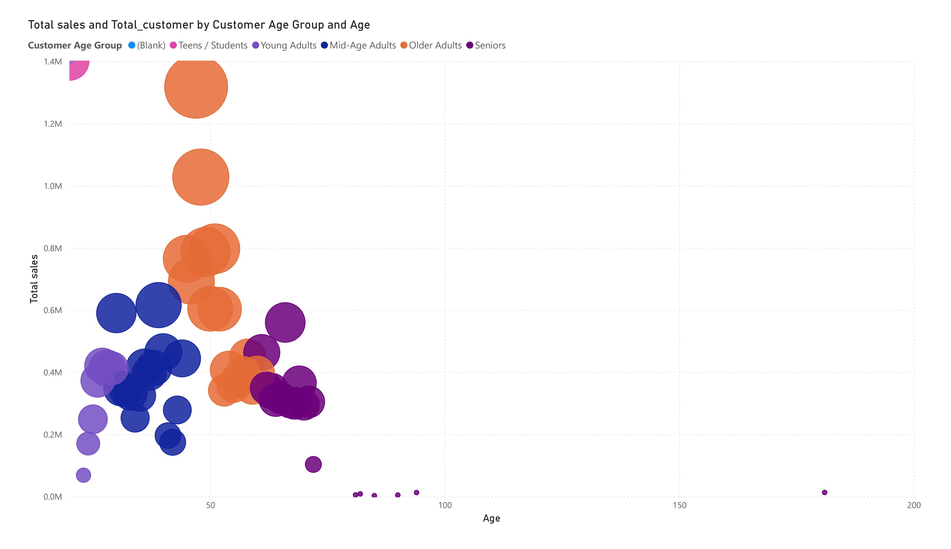
Primary Income Drivers: The most profitable customer segments are Mid-Age Adults (30–44) and Older Adults (45–60). These groups represent the core revenue base, likely due to higher disposable income, brand loyalty, and interest in quality or performance-focused gear. Age-Based Sales Balance: The sales distribution across age groups is relatively normal and balanced, suggesting broad market appeal across different demographics. However, certain age segments (e.g., under 30 and over 60) contribute less revenue, indicating growth opportunities or support needs in those areas.
Note: The data and information in this document is reflective of a hypothetical situation and client. This document is to be used for KPMG Virtual Internship purposes only.
Customer Segmentation by age
Age Group | Label | Description
< 20 | Teens / Students | Entry-level buyers, family-influenced purchases
20–29 | Young Adults | Urban commuters, active lifestyle, first-time buyers
30–44 | Mid-Age Adults | Likely to spend more, family bikes, health-focused
45–60 | Older Adults | Higher income, recreational use, possibly e-bikes
60+ | Seniors | Comfort bikes, health-focused, lower purchase frequency

Slide 11
🟧 For Mid-Age and Older Adults (30–60): ✅ Upsell premium products: Introduce high-performance bikes, accessories, or extended warranties. ✅ Loyalty programs: Create VIP programs or discounts for frequent buyers. ✅ Health & lifestyle positioning: Emphasize cycling’s physical and mental health benefits in marketing campaigns. ✅ After-sales service bundles: Offer tune-up packages, premium servicing, and trade-in options. 🟧 For Young Adults (20–29): ✅ Affordable entry models: Market budget-friendly commuter bikes or starter gear. ✅ Subscription or installment plans: Lower upfront cost barriers for new buyers. ✅ Digital engagement: Leverage social media, influencer partnerships, and interactive apps to build brand affinity. 🟧 For Seniors (60+): ✅ Comfort & e-bike focus: Highlight easy-riding, electric, or assisted bike models tailored for mobility. ✅ Education & support: Provide tutorials or guided service sessions for setup and maintenance. ✅ Community-building: Host local group rides or workshops targeting active seniors. 🟧 For Overall Balance: ✅ Segmented email campaigns based on age and buying behavior. ✅ Use Power BI dashboards to track age group trends monthly and adjust campaigns or inventory accordingly.
Note: The data and information in this document is reflective of a hypothetical situation and client. This document is to be used for KPMG Virtual Internship purposes only.
Strategic recommendations

Slide 12
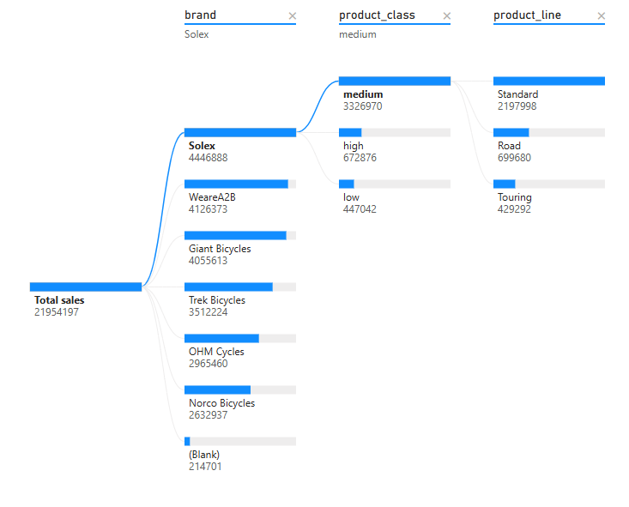
Note: The data and information in this document is reflective of a hypothetical situation and client. This document is to be used for KPMG Virtual Internship purposes only.
Product Overview
1. Casual Riders & Commuters
Profile:
Use bikes for daily transport.
Value durability, comfort, and affordability.
Prefer standard or mid-range models.
Lean toward well-known, practical brands (e.g., Solex, WeareA2B).
Behavior: Focused on value and longevity, not necessarily advanced features.
2. Sport Riders & Professional Cyclists
Profile:
Use bikes for sport, racing, or long-distance recreation.
Seek performance, innovation, and customization.
Favor high-end brands and components (e.g., Trek Bicycles).
Behavior: Willing to invest in top-tier products, often return buyers with specific upgrade paths.

Slide 13
Note: The data and information in this document is reflective of a hypothetical situation and client. This document is to be used for KPMG Virtual Internship purposes only.
Strategic Recommendation
For Casual Riders & Commuters:
✅ Product Strategy:
Emphasize reliability, low maintenance, and urban features (e.g. racks, lights, mudguards).
Stock mid-tier models that balance price and function.
✅ Brand Focus:
Push Solex and WeareA2B as core offerings with upgrade options.
✅ Marketing Strategy:
Highlight cost savings vs. driving, health benefits, and eco-friendliness.
Use real-life commute testimonials in campaigns.
✅ Sales Promotions:
Bundle locks, helmets, and service plans.
Promote seasonal discounts or commuter packages.
For Sport Riders & Professionals:
✅ Product Strategy:
Offer top-tier components, custom builds, and access to limited editions.
Provide in-depth consultations or bike fitting services.
✅ Brand Focus:
Promote Trek Bicycles and similar performance-focused brands.
✅ Marketing Strategy:
Showcase technical specs, performance stories, and race-oriented content.
Collaborate with local cycling clubs or sponsored athletes.
✅ Sales Promotions:
Offer upgrade paths (e.g. trade-in for carbon frames).
Provide loyalty rewards or early access to new tech/models.

Slide 14
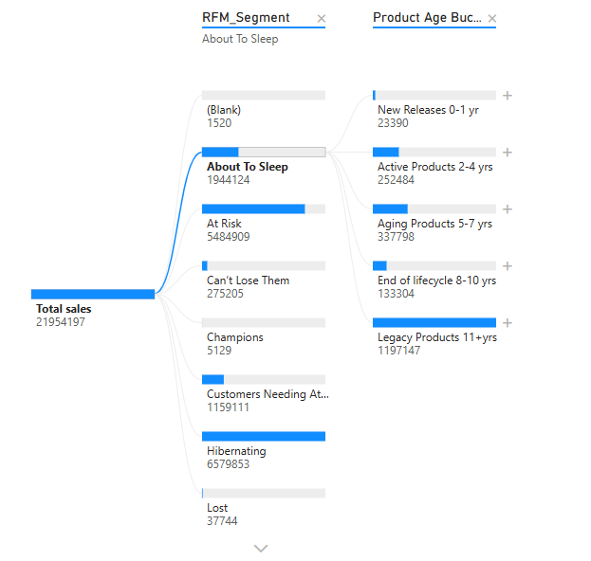
Note: The data and information in this document is reflective of a hypothetical situation and client. This document is to be used for KPMG Virtual Internship purposes only.
Product life cycle
Age Range | Label | Key Characteristics
0–1 years | New Releases | - Actively marketed- Under full warranty- Most current technology
2–4 years | Active Products | - Still widely sold- Regular maintenance may begin- Mid-life in product cycle
5–7 years | Aging Products | - Commonly serviced- Parts availability begins to decline- Warranty may end
8–10 years | End of Lifecycle | - Likely discontinued- Spare parts limited- Higher failure/replacement rates
11+ years | Legacy Products | - Out of support- Collector/secondary market only- Requires specialized service
A significant portion of low-engagement customers (categorized as Lost, About to Sleep, and Hibernating) are primarily purchasing premium products aged over 5 years — accounting for 60% of their total purchases.
At the same time, there is low general awareness of new product releases, indicating that marketing campaigns are not effectively reaching or engaging customers.
⚠️ This creates a high risk of customer churn, especially among valuable segments who may be disengaging due to lack of innovation visibility or outdated communication channels.

Slide 15
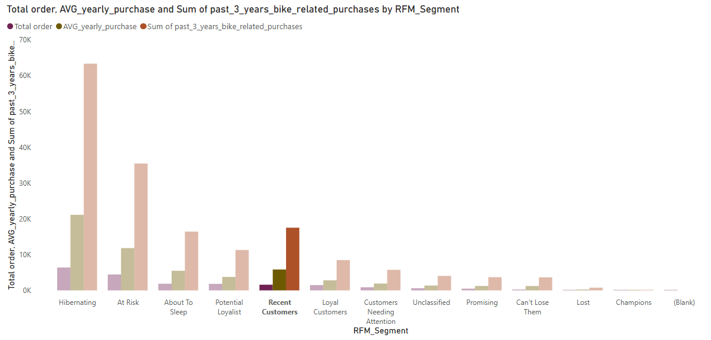
Note: The data and information in this document is reflective of a hypothetical situation and client. This document is to be used for KPMG Virtual Internship purposes only.
High risk of churning
Total customer orders in 2017 are significantly lower than the average yearly purchases from the previous three years (2014–2016). This indicates a clear downward trend in customer activity across segments.
⚠️ This trend strongly suggests a deterioration in engagement and purchasing behavior, pointing to a very high risk of customer churn if not addressed promptly.
Potential Causes:
Aging product portfolio not refreshed or promoted.
Ineffective marketing outreach, especially for new releases.
Declining relevance or satisfaction among long-term customers.
Market saturation or growing competition.

Slide 16
Note: The data and information in this document is reflective of a hypothetical situation and client. This document is to be used for KPMG Virtual Internship purposes only.
Strategic Recommendation
Issue | Insight | Recommended Strategy | Tactical Actions
Aged Product Dependency | Low-engagement customers mainly buy products >5 years old | Refresh their exposure to newer offerings | - Create targeted “Upgrade Your Ride” campaigns- Offer limited-time trade-in discounts
Low Awareness of New Releases | General customers are unaware of new models | Improve visibility of product innovation | - Launch teaser campaigns pre-release- Promote through influencers, YouTube reviews, newsletters
High Churn Risk | Long product life and weak engagement = inactivity | Reactivate dormant customers with targeted offers | - Personalized win-back emails- Push loyalty perks tied to trying new models
Marketing Ineffectiveness | Current campaigns are not segment-aware | Segment campaigns by engagement and product age | - Run A/B tests on messaging- Highlight "what's new" via tailored content
Premium Product Loyalty = Opportunity | Even low-engagement groups value quality | Leverage brand loyalty for retention | - Introduce loyalty tiers tied to premium brand purchases (e.g., early access, exclusive service)

Slide 17
Note: The data and information in this document is reflective of a hypothetical situation and client. This document is to be used for KPMG Virtual Internship purposes only.
Conclusion (further analysis from external insights)
Focus Area | Insight | Recommended Action
Product Innovation | Current product line is aging and lacks visibility into newer innovations | Develop new features and models that are cutting-edge and customizable to evolving customer needs
 |  | - Conduct A/B testing on prototypes, feature variations, and upgrade offers
Churn Risk Root Causes | Declining engagement and purchase trends suggest deeper customer disconnect | Perform in-depth churn analysis using survey data, feedback loops, and support ticket trends
Pricing Strategy | Possible misalignment between price and perceived value or market alternatives | Conduct market research and competitor benchmarking to evaluate and adjust the pricing model
Customer-Centric Design | One-size-fits-all approach may not work across diverse segments (commuters vs pros, sectors) | Use segmentation insights to develop tailored offerings per user group (commuter kits, pro packages)
Marketing & Messaging | Low awareness of new products and ineffective past campaigns | Refine messaging with personalization and behavior-driven content across all channels

Slide 18
Note: The data and information in this document is reflective of a hypothetical situation and client. This document is to be used for KPMG Virtual Internship purposes only.
Appendix
Links to report

